Slide 1

INTERNSHIP PROJECT
NAMED ENTITY RECOGNITION
Dr B R Ambedkar National Institute of Technology, Jalandhar
Department of Instrumentation and Control
Name : Bhanu Pratap Singh Chauhan
Roll No. : 18112019
Company Name : Samsung Research Institute, Bangalore
Internal Supervisor : Dr Sathiya S
Reporting Manager : Mr. Naresh Purre

Slide 2
PROBLEM STATEMENT
Named Entity Recognition (NER) is an NLP problem, which involves locating and classifying named entities (people, places, organizations etc.) mentioned in unstructured text.
The categories that the named entities are classified into are predefined and often contain entries like locations, organisations, job types, personal names, times and others.
An example of unstructured text presented to an NER system could be:
PM Modi visits Europe in their first overseas trip.
After processing the input, a NER model could output something like this:
[PM]_{Title} [Modi]_{Name} visits [Europe]_{Geography} in their first overseas trip.
My major focus was on recognizing the name of locations(Geography).

Slide 3
APPROACHES USED
Grammar-Based Techniques
This approach involves experienced linguists who manually define specific rules
for entity recognition.
Drawbacks:
This type of hand-crafted rule yields very high precision, but it requires a tremendous amount of work to define entity structures and capture edge cases.
Another drawback is that keeping such a grammar-based system up to date requires constant manual intervention and is a laborious task.

Slide 4
APPROACHES USED
2. Statistical Model-Based Techniques -
We can streamline and simplify the process of building NER models using Machine Learning.
The process of statistical learning can automatically extract said rules from a training dataset.
Moreover, keeping the NER model up to date can also be performed in an automated fashion.
Drawbacks:
The automated extraction of a comprehensive set of rules requires a large amount of labeled training data.

Slide 5
THE IOB FORMAT
Inside–outside–beginning (IOB) is a common format for tagging entities in computer linguistics, especially in a NER context.
The meaning of the IOB tags is as follows:
the I-prefix indicates that the tag is inside a chunk
the O-prefix indicates that the token belongs to no chunk
the B-prefix indicates that the tag is at the beginning of a chunk that follows another chunk without O tags between the two chunk
Eg. Sentence = “I love New York”
Labels = [O O B I]

Slide 6
DATA PREPROCESSING
Some of the steps that I have used while preprocessing the data are as follows:
Replacing the NaN values with their respective values using some statistical methods.
We calculated some statistics about the data just to get familiar to the data like finding the distribution of differents tags, finding most frequent POS, etc.
We then build a dictionary (word2index) that assigns a unique integer value to every word from the corpus. We also construct a reversed dictionary that maps indices to words (index2word).
We also need to pad each sentence to the maximal sentence length in the corpus, as the LSTM model expects a fixed length input.
The last transformation we need to perform is to one-hot encode the labels.
Finally, we split the resulting dataset into a training and testing set, so that we can measure the performance of the classifier on unseen data.

Slide 7
MODELS USED
Models which are used for this task are as follows:
RNN
LSTM
BI-LSTM
CRF
BI-LSTM-CRF

Slide 8
Recurrent Neural Network
RNN structure has an input layer x, hidden layer h and output layer y. In NER context, x represents input features and y represents tags.
An input layer represents features at time t. They could be one-hot-encoding for word feature, dense vector features, or sparse features. An input layer has the same dimensionality as feature size.
An output layer represents a probability distribution over labels at time t. It has the same dimensionality as size of labels.
The values in the hidden and output layers are computed as follows:
h(t) = f(Ux(t) + Wh(t − 1)), where f(x) = sigmoid function
2. y(t) = g(Vh(t)) , where g(x) = softmax function
where U, W, and V are the connection weights to be computed in training time.

Slide 9
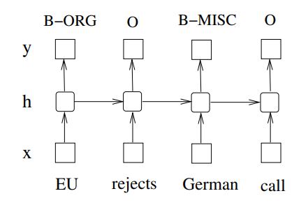
Recurrent Neural Network

Slide 10
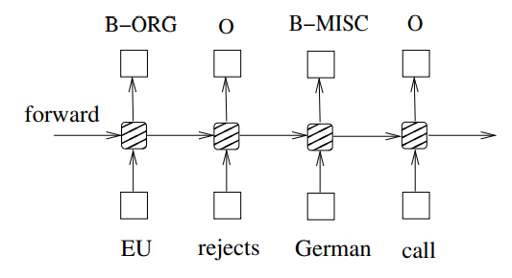
Long Short Term Memory
Long Short-Term Memory networks are the same as RNNs, except that the hidden layer updates are replaced by purpose-built memory cells. As a result, they may be better at finding and exploiting long range dependencies in the data.

Slide 11
Bi-Directional Long Short Term Memory
In sequence tagging task, we have access to both past and future input features for a given time, we can thus utilize a bidirectional LSTM network.
We efficiently made use of past features (via forward states) and future features (via backward states) for a specific time frame.
The forward and backward passes over the unfolded network over time are carried out in a similar way to regular network forward and backward passes, except that we need to unfold the hidden states for all time steps.

Slide 12
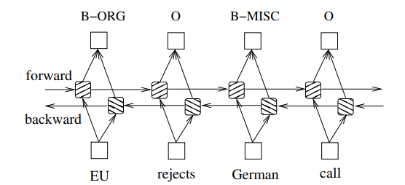
Bi-Directional Long Short Term Memory

Slide 13
Conditional Random Field
Conditional random field (CRF) is a statistical model well suited for handling NER problems.
When a CRF model makes a prediction, it factors in the impact of neighbouring samples by modelling the prediction as a graphical model.
For example, a linear chain CRF is a popular type of a CRF model, which assumes that the tag for the present word is dependent only on the tag of just one previous word.
Drawbacks
They are capable of capturing the dependencies between labels in the forward direction only.
So, for eg, if the model encounters an entity like "Dr B R Ambedkar National Institute of Technolgy,Jalandhar" it will likely tag the Ambedkar token as a name, because the model is "blind" to the token that appears downstream.

Slide 14
BI-LSTM-CRF
We resolve this challenge by introducing a bidirectional LSTM (BiLSTM) network between the inputs (words) and the CRF.
The bidirectional LSTM consists of two LSTM networks -
one takes the input in a forward direction, and
second one taking the input in a backward direction.
Combining the outputs of the two networks yields a context that provides information on samples surrounding each individual token.
The output of the BiLSTM is then fed to a linear chain CRF, which can generate predictions using this improved context.

Slide 15
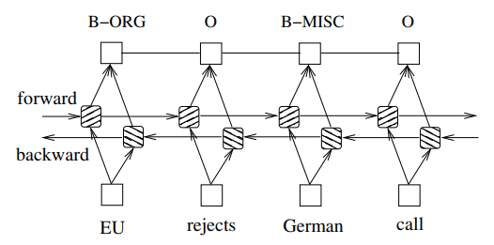
BI-LSTM-CRF

Slide 16
Final Algorithm
1: for each epoch do
2: for each batch do
3: 1) bidirectional LSTM-CRF model forward pass:
4: forward pass for forward state LSTM
5: forward pass for backward state LSTM
6: 2) CRF layer forward and backward pass
7: 3) bidirectional LSTM-CRF model backward pass:
8: backward pass for forward state LSTM
9: backward pass for backward state LSTM
10: 4) update parameters
11: end for
12: end for

Slide 17
Results and Future Work
By using the BiLSTM-CRF network, we were able to achieve an accuracy of 91.49% on our testing Dataset while keeping the size of the model under permissible limits.
Next thing, we will be doing is to test our model on more dataset to make sure that it is giving the results as per our expectation.
After testing, We will be converting our model into tflite to make the model capable to go into production.

Slide 18
Thank You

